Slide 1
Guidelines and Demo
Hege Web Application
Vasilache Diana

Slide 2
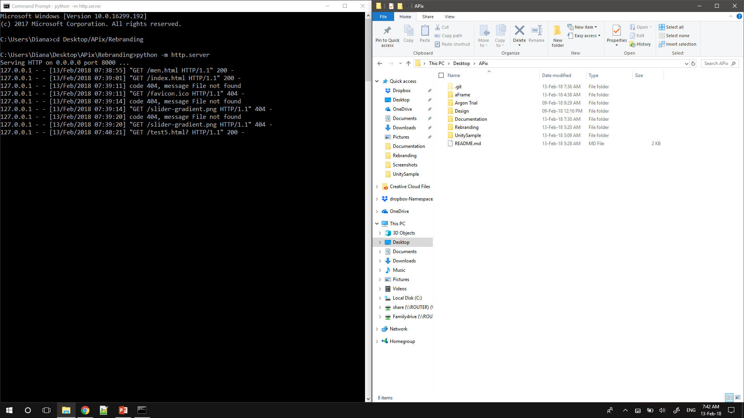
1.First, set up the local server.

Slide 3
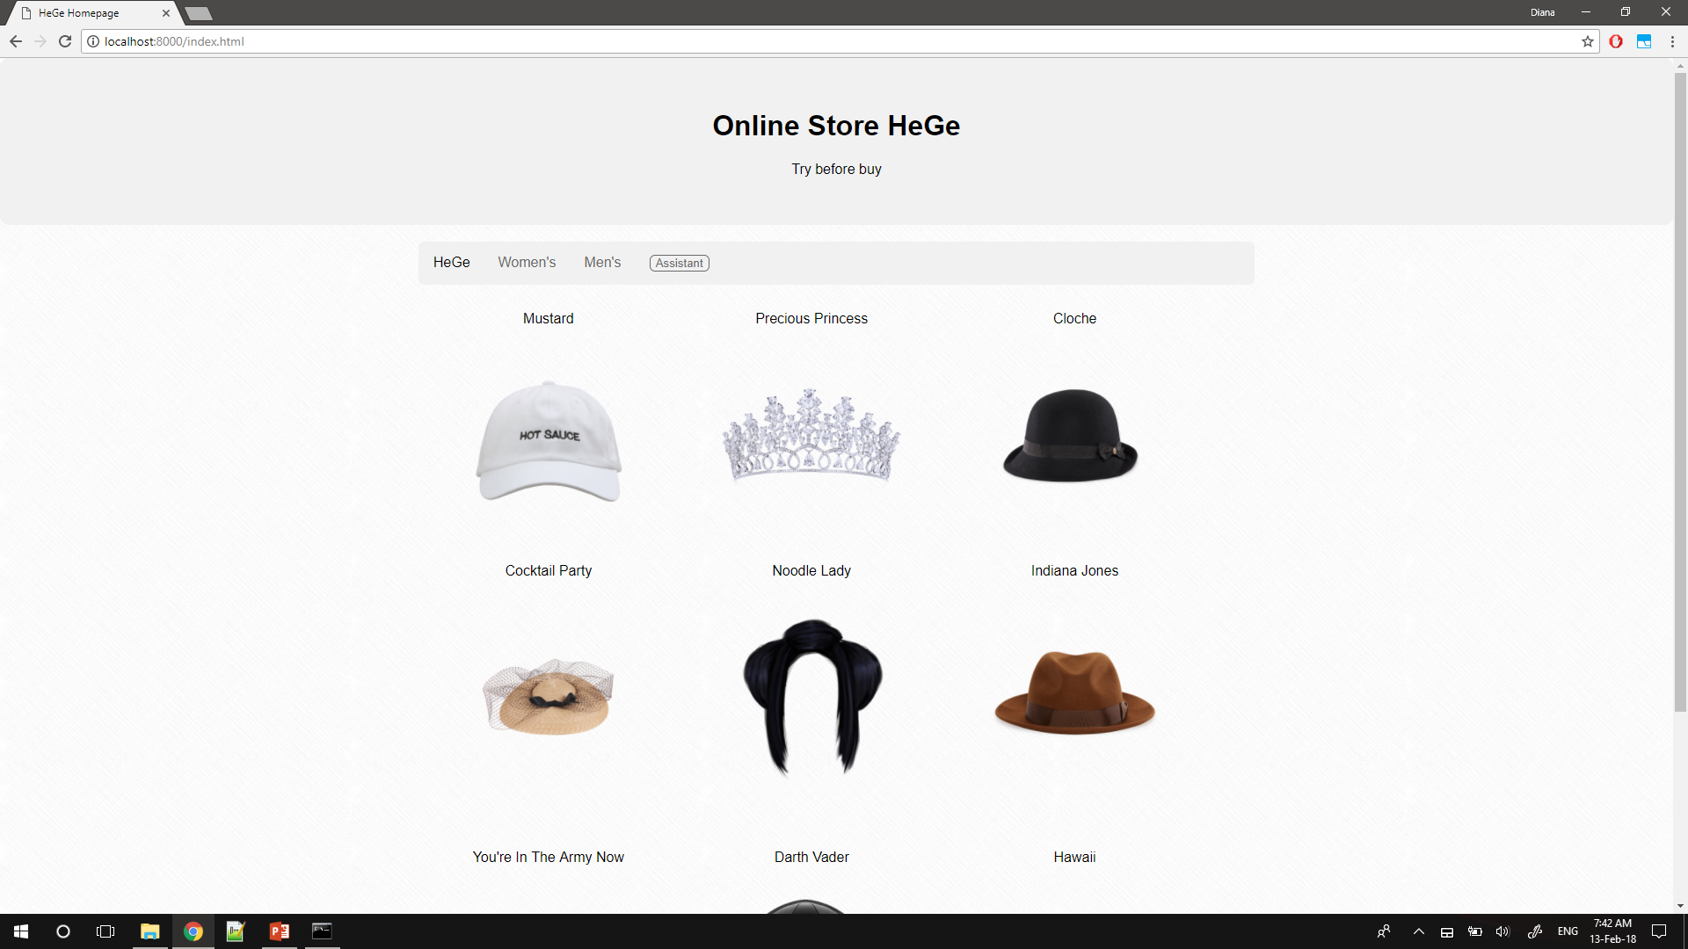
2. Open localhost8000

Slide 4
2.1 Welcome to the homepage of the app!

Slide 5
2.2 To navigate to Women’s Headgear and Men’s Headgear or back to homepage, click on the navbar items accordingly.

Slide 6
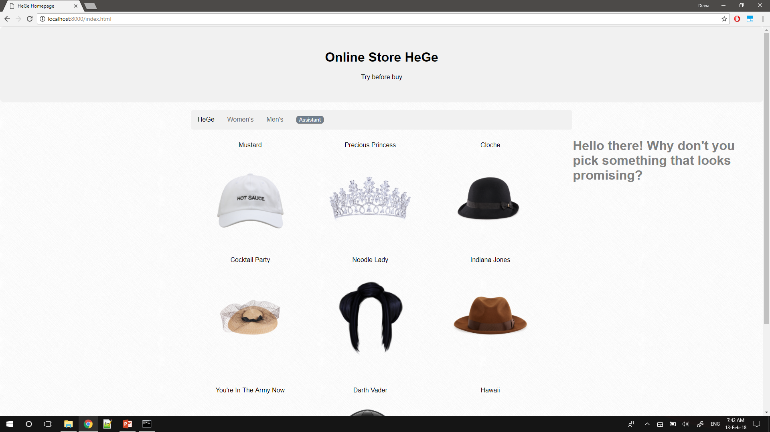
3.Press Assistant button for help

Slide 7

4. Choose an item from page.

Slide 8
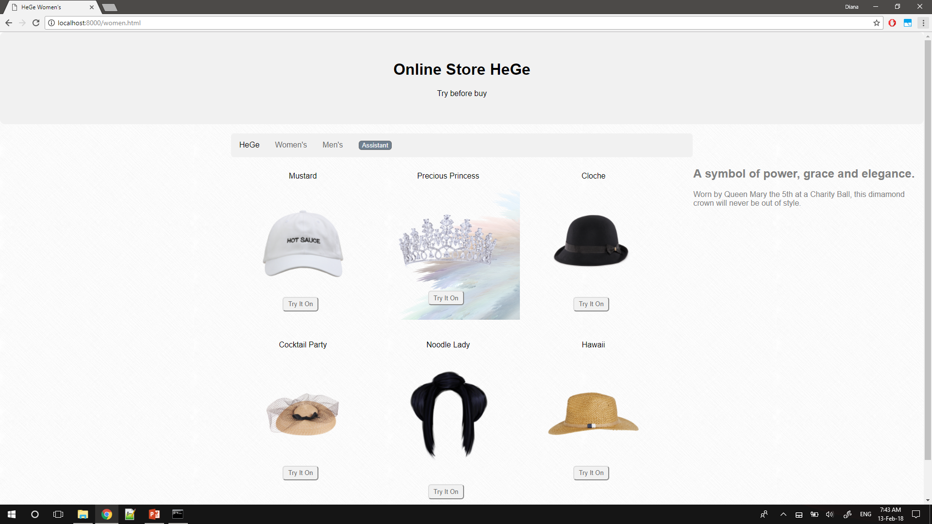
5. You’ll be redirected to Women’s or Men’s. You can further enquire the assistant by pressing the assistant button.

Slide 9
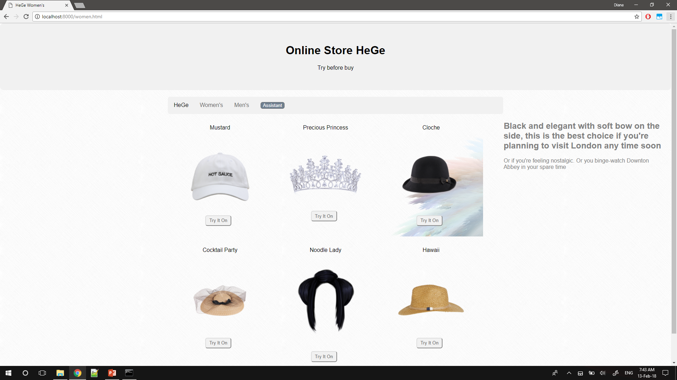
6. The assistant will continue to give you advice as long as you keep pressing the assistant button

Slide 10
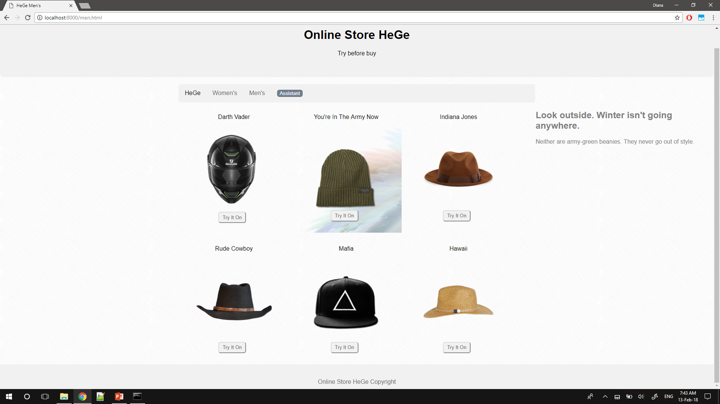
7. The same deal on the Men’s Headgear page.

Slide 11
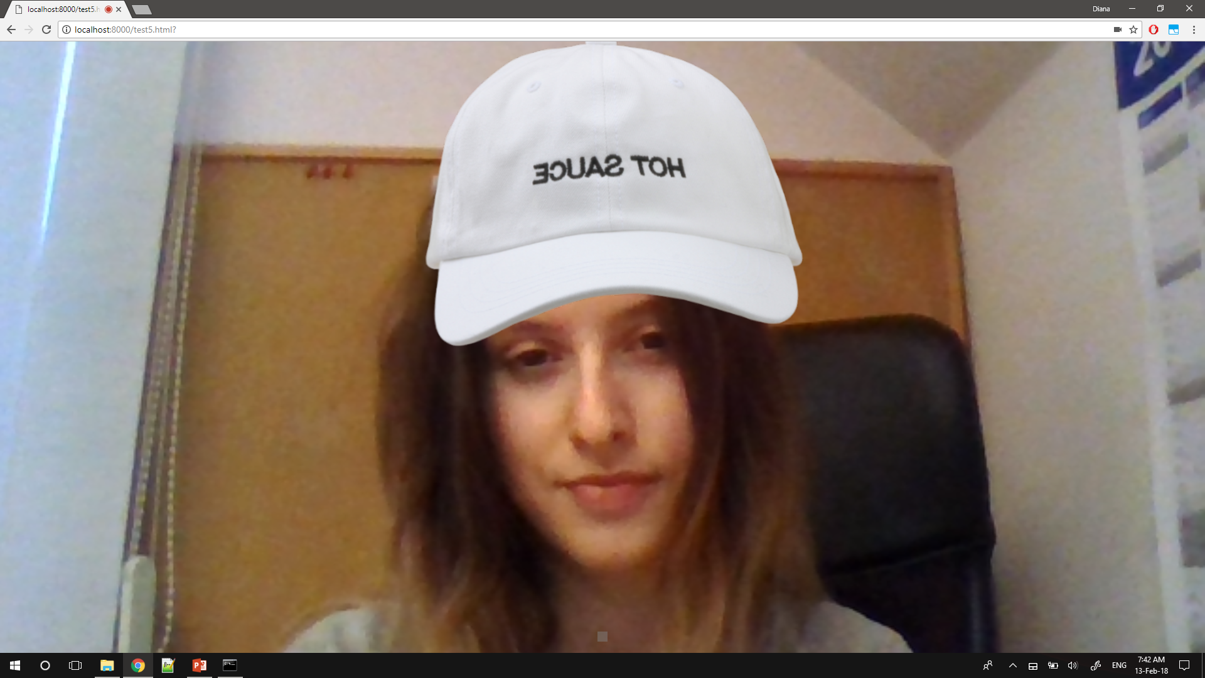
8. Press button “Try It On” to open webcam and see how you look. If webcam requests permission, allow it.

Slide 12
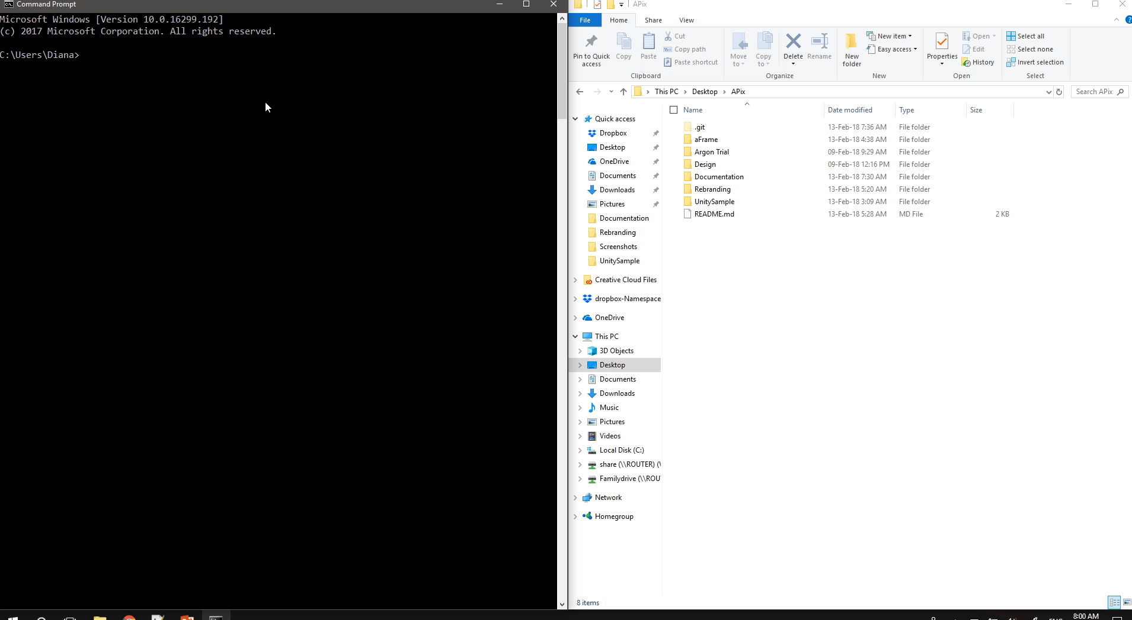
Short Video Demo

